Slide 1


OVERVIEW
HANDBOOK ON
THE FINANCIAL TRANSACTIONS
OF THE
SANGGUNIANG KABATAAN (SK)

Slide 2





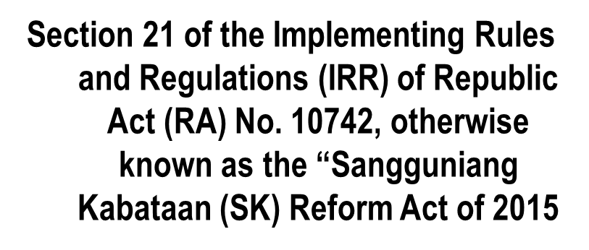

Legal
Basis
Overview on the Handbook on the Financial Transactions of the SK

Slide 3

RA 10742
Overview on the Handbook on the Financial Transactions of the SK

Slide 4

Background Information IRR of RA 10742
Formulate the CBYDP and ABYIP
Approve the annual and supplemental SK budget
Promulgate resolutions for SK objectives
Powers and Functions
of the SK
Sec. 8, IRR of RA 10742
Overview on the Handbook on the Financial Transactions of the SK

Slide 5
Background Information IRR of RA 10742
4. Initiate and implement youth programs and projects
5. Hold fund-raising activities in line with the CBYDP
6. Create regular or special committees
Powers and Functions
of the SK
Sec. 8, IRR of RA 10742
Overview on the Handbook on the Financial Transactions of the SK

Slide 6
Background Information IRR of RA 10742
7. Submit the annual and end-of-term program accomplishments and financial reports to the Sangguniang Barangay, present the same to the KK assembly copy furnished LGOO, LYDC, COA and NYC
Powers and Functions
of the SK
Sec. 8, IRR of RA 10742
Overview on the Handbook on the Financial Transactions of the SK

Slide 7
Background Information IRR of RA 10742
8. Adopt and implement a policy of full public disclosure of all transactions and documents involving public interest.
Powers and Functions
of the SK
Sec. 8, IRR of RA 10742
Overview on the Handbook on the Financial Transactions of the SK

Slide 8
Background Information IRR of RA 10742
9. Authorize the SK Chairperson to enter into contracts on behalf of the SK, subject to RA 10742, RA 7160 and RA 9184
Powers and Functions
of the SK
Sec. 8, IRR of RA 10742
Overview on the Handbook on Financial Transactions of the SK

Slide 9
Background Information IRR of RA 10742
10. Comply with the bonding requirements
Powers and Functions
of the SK
Sec. 8, IRR of RA 10742
Overview on the Handbook on Financial Transactions of the SK

Slide 10




DBM-DILG-NYC
Joint Memorandum Circular (JMC) No. 1
January 23, 2019
Overview on the Handbook on Financial Transactions of the SK

Slide 11



JMC No. 1
General Guidelines
Appropriation of the SK Funds
Release of the SK Funds
Planning and Budgeting process for the SK Funds
- Comprehensive Barangay Youth Development
Plan (CBYDP)
- Annual Barangay Youth Development
Investment Program (ABYIP)
JMC Sec. 3.0
Overview on the Handbook on Financial Transactions of the SK

Slide 12
JMC No. 1
General Guidelines
Budgeting Process
- Budget Preparation
- Budget Authorization
- Budget Review
- Budget Execution
- Accountability Reports
JMC Sec. 3.0
Overview on the Handbook on Financial Transactions of the SK

Slide 13
JMC No. 1
Cases
for
Resolution
Cases not covered by the JMC shall be referred to the NYC for joint resolution by the DBM, NYC and DILG
JMC Sec. 7.0
Overview on the Handbook on Financial Transactions of the SK

Slide 14
Overview on the Handbook on Financial Transactions of the SK

Slide 15
Definition of Terms
Basic Standards and Policies
Procedures/Flowcharts
Forms, Registers, Registries
Records and Reports
Accounting Plan
Overview on the Handbook on Financial Transactions of the SK

Slide 16

BASIC STANDARDS AND POLICIES
DEFINITION OF TERMS
Annual Budget
Commitments
Fair Value
Approved Budget
Disbursements/
Payments
SK Funds
Overview on the Handbook on Financial Transactions of the SK

Slide 17
BASIC STANDARDS AND POLICIES
DEFINITION OF TERMS
Semi-expendable property
Supplies and Materials
Receipts/
Collections
Property and Equipment
Reporting Period
Supplemental Budget
Overview on the Handbook on Financial Transactions of the SK

Slide 18
BASIC STANDARDS AND POLICIES
Financial
Independence
in:
SK operations
Disbursements and encashment of its funds, income and expenditures
SK funds deposited in the name of the SK in GOB/AGDB with the SK chairperson and SK treasurer as signatories
Overview on the Handbook on Financial Transactions of the SK

Slide 19
BASIC STANDARDS AND POLICIES
Financial
Independence
in:
10 percent of Barangay Fund shall be set aside for the SK.
SK FUND
The Sangguniang Barangay shall appropriate the SK fund in lump sum.
Overview on the Handbook on Financial Transactions of the SK

Slide 20
BASIC STANDARDS AND POLICIES
Financial
Independence
in:
SK fund automatically released, not subject to any lien or holdback
SK FUND
10% SK share from the barangay released to SK not later than 5 working days from receipt of the IRA by the barangay.
Overview on the Handbook on Financial Transactions of the SK

Slide 21
BASIC STANDARDS AND POLICIES
Financial
Independence
in:
SK funds are deposited in the current account of the SK not later than 5 WDs after the crediting of the monthly IRA share of the barangay.
SK FUND
All monies officially received by the SK officials in any capacity or on any occasion shall be accounted as SK Fund, unless otherwise provided by law.
Overview on the Handbook on Financial Transactions of the SK

Slide 22

BASIC STANDARDS AND POLICIES
10% of the GF of the Barangay
proceeds from fund-raising activities aligned with CBYDP and ABYIP
contributions, monies and all other resources received without specific purposes
funds received for specific purposes
SK Funds Consist
of:
Overview on the Handbook on Financial Transactions of the SK

Slide 23
utilized in accordance with the approved budget of the SK
SK Funds
Shall
be:
allocated in an annual budget, and if funds allow, in a supplemental budget in accordance with the adopted ABYIP
(Section 20(c) of the IRR of R.A. No. 10742)
Overview on the Handbook on Financial Transactions of the SK

Slide 24
  Utilization of SK funds for youth development and empowerment purposes
Equitable access to Quality Education
Environmental Protection
Climate Change Adaptation
Disaster Risk Reduction and Resiliency
Youth Employment and Livelihood
Health and Anti-drug Abuse
Gender Sensitivity
Sports Development
Capability Building which emphasizes leadership training
(Section 20a and 20c of the IRR)
Overview on the Handbook on Financial Transactions of the SK

Slide 25

BASIC STANDARDS AND POLICIES
SK Funds disbursed
pursuant
to:
RA No. 10742 and its IRR
RA No. 7160
RA No. 9184
Other pertinent LRR
(Section 20 of the IRR of R.A. No. 10742)
Overview on the Handbook on Financial Transactions of the SK

Slide 26
BASIC STANDARDS AND POLICIES
SK Funds disbursed
pursuant
to:
Other pertinent LRR
DBM, DILG NYC JMC -01
COA Circular 2012-001
RA 11768
LBC No. 148
Treasury Circulars 02-2009,and 01-2022
Overview on the Handbook on Financial Transactions of the SK

Slide 27

BASIC STANDARDS AND POLICIES
All revenues/receipts shall at all times be properly acknowledged by an Official Receipt
Disbursements/payments or disposition of the SK funds or property shall bear the approval of the proper officials
All claims/disbursements shall be supported with complete documentation
Overview on the Handbook on Financial Transactions of the SK

Slide 28


BASIC STANDARDS AND POLICIES
SK Chairperson shall be immediately and primarily responsible for all the funds and property pertaining to the SK
SK Treasurer shall be responsible in the proper handling or custody of the funds and property of the SK
Overview on the Handbook on Financial Transactions of the SK

Slide 29
BASIC STANDARDS AND POLICIES
The SK Chairperson with the concurrence of the majority of all the SK members shall designate a Budget Monitoring Officer (BMO) who shall be responsible in monitoring the SK budget and preparation of budget reports. The BMO shall come from the SK officials
Overview on the Handbook on Financial Transactions of the SK

Slide 30
BASIC STANDARDS AND POLICIES
Every accountable officer shall be properly bonded in accordance with law:
- Sec. 101, PD 1445
EO No. 292
Treasury Circular No. 02-2009
other pertinent issuances of the BTR
Overview on the Handbook on Financial Transactions of the SK

Slide 31

BASIC STANDARDS AND POLICIES
SK financial transactions shall be kept under cash basis of accounting using a single-entry bookkeeping system and recorded in accordance with the list of accounts provided in the HFTSK
Overview on the Handbook on Financial Transactions of the SK

Slide 32

BASIC STANDARDS AND POLICIES
Cash Basis
records transactions and events only when cash is received or paid
Non-cash transactions are reported in the NTFS
Overview on the Handbook on Financial Transactions of the SK

Slide 33
BASIC STANDARDS AND POLICIES
Cash Basis
FS provide readers with information about the sources of cash received, the purposes for which the cash was used and the cash balance
focus is on cash liquidity
Overview on the Handbook on Financial Transactions of the SK

Slide 34






SK TRANSACTION AREAS
Receipts/
Collections
and
Deposits
Disbursements/
Payments
Supplies and Materials
Property and Equipment
Financial Statements Other Reports
Budget
Overview on the Handbook on Financial Transactions of the SK

Slide 35

Who is the Budget Monitoring Officer?
Registry of Budget, Commitments, Payments and Balances (RBCPB)
Registry of Specific Purpose Fund, Commitments, Payments and Balances (RSPFCPB)
Summary of Budget, Commitments, Payments and Balances
Summary of Specific Purpose Fund, Commitments, Payments and Balances
Statement of Comparison of Budget and Actual Amounts
Budget
Overview on the Handbook on Financial Transactions of the SK

Slide 36

Receipts/Collections
and Deposits
Who is the SK’s Collecting Officer?
Register of Cash Receipts, Deposits and Other Related Financial Transactions (RCRD)
Register of Cash in Bank and Other Related Financial Transactions (RCB)
Statement of Receipts and Payments (SRP)
Overview on the Handbook on Financial Transactions of the SK

Slide 37

Disbursements
Who is the SK’s Disbursing Officer?
Disbursement voucher
Check payment
Register of Cash in Bank and Other Related Financial Transactions (RCB)
Overview on the Handbook on Financial Transactions of the SK

Slide 38

Supplies and Materials
Supplies and Materials/Semi-expendable property
Who is the SK’s Supply Officer?
RA No. 9184
What committees are created?
What records are maintained?
Overview on the Handbook on Financial Transactions of the SK

Slide 39

Property and Equipment
Tangible property of P15,000 and up
RA No. 9184
What records are maintained?
Overview on the Handbook on Financial Transactions of the SK

Slide 40

Financial Statements
and other reports
SRP – Statement of Receipts and Payments
SCBAA – Statement of Comparison of Budget and Actual Amounts
NFS – Notes to Financial Statements
RIPSM/RIDSM – Report on Inventory of Purchased Supplies and Materials / Report on Inventory of Donated Supplies and Materials
Overview on the Handbook on Financial Transactions of the SK

Slide 41

Financial Statements
and other reports
RIPPE/RIDPE – Report on Inventory of Purchased Property & Equipment/
Report on Inventory of Donated Property & Equipment
SBCPB – Summary of Budget, Commitments, Payments and Balances
SSPFCPB – Summary of Special Purpose Fund, Commitments, Payments and Balances
BRS – Bank Reconciliation Statement
RAAF - Registry of Accountability for Accountable Forms
Overview on the Handbook on Financial Transactions of the SK

Slide 42

All accountable forms, records, registers, registries, DVs and SDs, and reports of SK shall be made available for audit by the COA Auditor concerned
Overview on the Handbook on Financial Transactions of the SK

Slide 43

Accounting Plan for the SK financial transactions
Overview on the Handbook on Financial Transactions of the SK

Slide 44
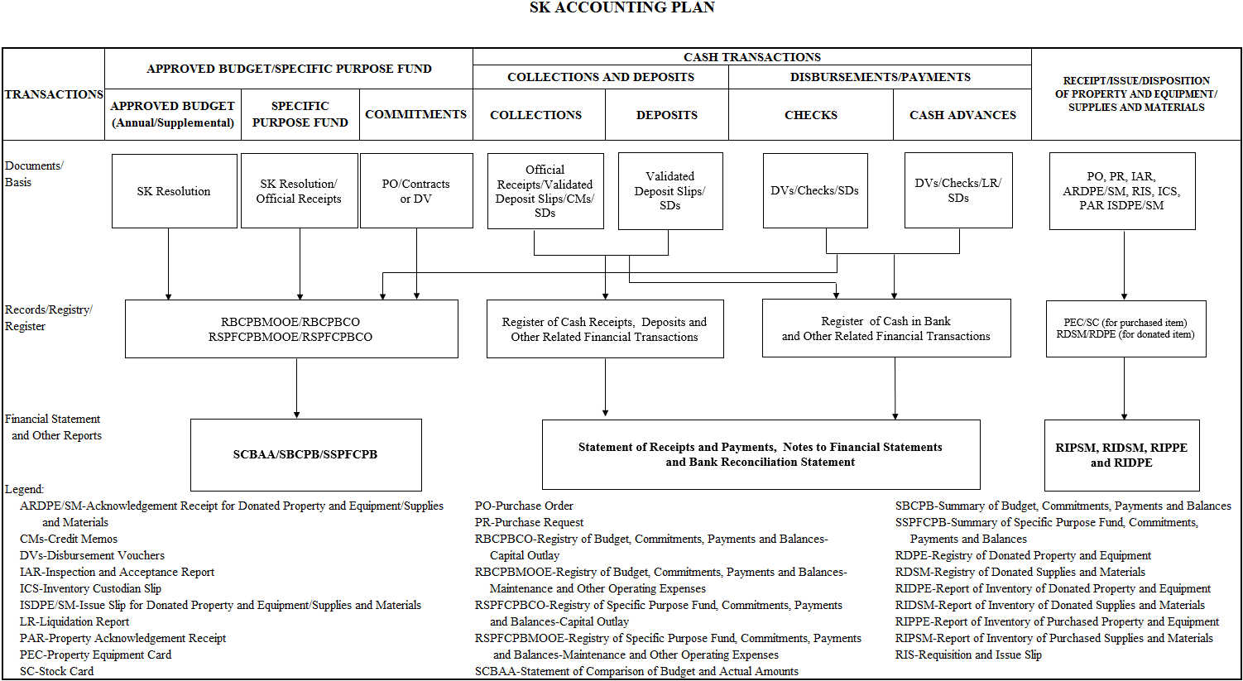
RBCPBPS/RBCPBMOOE/RBCPBCO
RSPFCPBMOOE/RSPFCPBCO

Slide 45

Budget
Annual Budget/ Supplemental Budget
Funds Received for Specific Purpose
Commitments
Disbursement/
Payment
Documents/ Basis
SK Resolution and Copy of the Approved Budget
SK Resolution and Copy of OR
PO/Contract/DV
Paid DV/SDs
Registry
Registry of Budget, Commitments, Payments and Balances (RBCPB)
Registry of Specific Purpose Fund, Commitments, Payments and Balances (RSPFCPB)
FS and Other Reports
Summary of Budget, Commitments, Payments and Balances (SBCPB)
Summary of Specific Purpose Fund, Commitments, Payments and Balances (SSPFCPB)
Statement of Comparison of Budget and Actual Amounts (SCBAA)
Overview on the Handbook on Financial Transactions of the SK

Slide 46
Collections and Deposits
COLLECTIONS
DEPOSITS
Documents/Basis
ORs/VDSs/CMs/SDs
VDSs/SDs
Records/Registry/ Register
Register of Cash Receipts, Deposits and Other Related Financial Transactions (RCRD)
Register of Cash in Bank and Other Related Financial Transactions (RCB)
FS and Other Reports
Statement of Receipts and Payments (SRP)
Notes to Financial Statements
Bank Reconciliation Statement
Overview on the Handbook on Financial Transactions of the SK

Slide 47
Disbursements/Payments
CHECKS
CASH ADVANCES
Documents/ Basis
DVs/Checks/SDs
DVs/Checks/LR/SDs
Registry/ Register
RBCPB/RSPFCPB
Register of Cash in Bank and Other Related Financial Transactions (RCB)
FS and Other Reports
SCBAA/SBCPB/ SSPFCPB
Statement of Receipts and Payments (SRP)
Notes to Financial Statements
Bank Reconciliation Statement
Overview on the Handbook on Financial Transactions of the SK

Slide 48
RECEIPT/ISSUE/DISPOSITION OF PROPERTY AND EQUIPMENT/SUPPLIES AND MATERIALS
Documents/Basis
PO, PR, IAR, ARDPE/SM,
RIS, ICS, PAR ISDPE/SM
Records/Registry/ Register
PEC/SC (for purchased item)
RDSM/RDPE (for donated item)
FS and Other Reports
RIPSM, RIDSM, RIPPE and RIDPE
Overview on the Handbook on Financial Transactions of the SK

Slide 49

THANK YOU

